Slide 1
Arrays ADT
Data structures

Slide 2
Arrays
An array is defined as
Ordered collection of a fixed number of elements
All elements are of the same data type
Basic operations
Direct access to each element in the array
Values can be retrieved or stored in each element

Slide 3
Properties of an Array
Ordered
Every element has a well-defined position
First element, second element, etc.
Fixed size or capacity
Total number of elements are fixed
Homogeneous
Elements must be of the same data type (and size)
Use arrays only for homogeneous data sets
Direct access
Elements are accessed directly by their position
Time to access each element is same
Different to sequential access where an element is only accessed after the preceding elements

Slide 4
Declaring Arrays in C/C++
datatype arrayName[intExp];
datatype – Any data type, e.g., integer, character, etc.
arrayName – Name of array using any valid identifier
intExp – Constant expression that evaluates to a positive integer
const int SIZE =10;
int list[SIZE];
Compiler reserves a block of consecutive memory locations enough to hold SIZE values of type int

Slide 5
Accessing Arrays in C/C++
arrayName[indexExp];
indexExp – called index, is any expression that evaluates to a positive integer
In C/C++
Array index starts at 0
Elements of array are indexed 0, 1, 2, …, SIZE-1
[ ] is called array subscripting operator
int value =list[2]
list[0]=value*2;

Slide 6
C/C++ Implementation of an Array ADT
As an ADT | In C/C++
Ordered | Index: 0,1,2, … SIZE-1
Fixed Size | intExp is constant
Homogeneous | dataType is the type of all elements
Direct Access | Array subscripting operator [ ]

Slide 7
Array Initialization in C/C++
dataType arrayName[intExp]={list ofvalues}
In C/C++, arrays can be initialized at declaration
intExp is optional: Not necessary to specify the size
Example: Numeric arrays
double score[]={0.11, 0.13,0.16, 0.18,0.21}
0 1 2 3 4
0.11 0.13 0.16 0.18 0.21
score

Slide 8
Array Initialization in C/C++
Fewer values are specified than the declared size of an array
Numeric arrays: Remaining elements are assigned zero
Character arrays: Remaining elements contains null character ‘\0’ ASCII code of ‘\0’ is zero
double score[5] = {0.11, 0.13, 0.16}
char name[6] = {‘J’, ‘O’, ‘H’, ‘N’}
0 1 2 3
0.11 0.13 0.16 0
4
0
score
0
name J
1
O
2
H
3
N
4 5
\0 \0
If more values are specified than declared size of an array
Error is occurred: Handling depends on compiler

Slide 9
Array Addressing
list
list[0]
1000
1001
Consider an array declaration: int list[4] ={1, 2, 4, 5}
Compiler allocates a block of four memory spaces
Each memory space is large enough to store an int value
Four memory spaces are contiguous
Base address
Address of the first byte (or word) in the contiguous block of memory
Address of the memory location of the first array element
Address of element list[0]
Memory address associated with array_Name stores the base address
cout << list << endl;
cout << *list << endl;
1002
list[1]
1003
1004
1005
1006
1007
1008
1009
1010
list[2]
list[3]
1011
1012
1013
1014
1015
* is dereferencing operator Returns content of a memory location

Slide 10
Array Addressing
Consider a statement: cout<<list[3];
Requires array reference list[3]be translated into memory address
Offset: Determines the address of a particular element w.r.t. base address
Translation
Base address + offset = 1000 + 3 x sizeof(int)=1012
Content of address 1012 are retrieved & displayed
An address translation is carried out each time
an array element is accessed
What will be printed and why?
cout<<*(list+3)<<endl;
list
list[0]
1000
1001
1002
list[1]
1003
1004
1005
1006
1007
1008
1009
1010
list[2]
list[3]
1011
1012
1013
1014
1015

Slide 11
Multidimensional Arrays
Most languages support arrays with more than one dimension
High dimensions capture characteristics/correlations associated with data
Example: A table of test scores for different students on several tests
2D array is suitable for storage and processing of data
 | Test 1 | Test 2 | Test 3 | Test 4
Student 1 | 99.0 | 93.5 | 89.0 | 91.0
Student 2 | 66.0 | 68.0 | 84.5 | 82.0
Student 3 | 88.5 | 78.5 | 70.0 | 65.0
: | : | : | : | :
: | : | : | : | :
Student N | 100.0 | 99.5 | 100.0 | 99.0

Slide 12
Two Dimensional Arrays – Declaration
dataType arrayName[intExp1][intExp2];
intExp1 – constant expression specifying number of rows
intExp2 – constant expression specifying number of columns
Example:
const int NUM_ROW =2, NUM_COLUMN = 4;
double scoreTable [NUM_ROW][NUM_COLUMN];
Initialization:
Double scoreTable [][4] = {{0.5, 0.6,0.3},
{0.6,0.3,0.8}};
List the initial values in braces, row by row
May use internal braces for each row to improve readability

Slide 13
Two Dimensional Arrays – Processing
arrayName[indexExp1][indexExp2];
indexExp1 – row index
indexExp2 – column index
Rows and columns are numbered from 0
Use nested loops to vary two indices
Row-wise or column-wise manner
 | Test 1 | Test 2 | Test 3 | Test 4
Student 1 | 99.0 | 93.5 | 89.0 | 91.0
Student 2 | 66.0 | 68.0 | 84.5 | 82.0
Student 3 | 88.5 | 78.5 | 70.0 | 65.0
: | : | : | : | :
: | : | : | : | :
Student N | 100.0 | 99.5 | 100.0 | 99.0

Slide 14
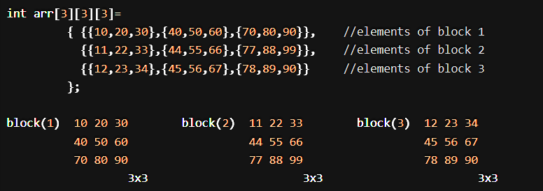
Higher Dimensional Arrays
Example: Store and process a table of test scores
For several different students
On several different tests
Belonging to different semesters
const int SEMS =10, STUDENTS = 30, TESTS = 4;
double ThreeDimArray[SEMS][STUDENTS][TESTS];
What is represented by gradebook[4][2][3]?
Score of 3rd student belonging to 5th semester on 4th test
Notes:
A 3D array is a multi-dimensional array(array of arrays). A 3D array is a collection of 2D arrays . It is specified by using three subscripts:Block size, row size and column size. More dimensions in an array means more data can be stored in that array.

Slide 15
Array of Arrays
score
[0] [1] [2] [3]
[0]
[1]
Consider the declaration
double score[10][4];
Another way of declaration
One-dimensional (1D) array of rows
double RowOfTable[4];
RowOfTable score[10];
In detail
Declare score as 1D array containing 10 elements
Each of 10 elements is 1D array of 4 real numbers (i.e., double)
[2]
[3]
...
...
...
...
[9]
score
[0]
[1]
[2]
[3]
[0] [1]
[2]
[3]
...
...
...
...
[9]

Slide 16
Array of Arrays
Score[i]
Indicates i^{th} row of the table
Score[i][j]
Can be thought of as (score[i])[j]
Indicates j^{th} element of score[i]
An n-dimensional array can be viewed (recursively) as a 1D array whose elements are (n-1)-dimensional arrays

Slide 17
Implementing Multidimensional Arrays
More complicated than one dimensional arrays
Memory is organized as a sequence of memory locations
One-dimensional (1D) organization
How to use a 1D organization to store multidimensional data?
Example:
A character requires single byte
Compiler request to reserve 12 consecutive bytes
Two way to store consecutively, i.e., row-wise and column-wise
A E I
B F J
C G K
D H L

Slide 18
Two-dimensional Arrays in Memory
Two ways to be represented in memory
Column majored
Column by column
Row majored
Row by row
Representation depends upon the programming language
 | (1,1) (2,1) (3,1)
 |  | Column 1
 | (1,2)
 | (2,2) | Column 2
 | (3,2)
 | (1,3)
 | (2,3) | Column 3
 | (3,3)
 | (1,4)
 | (2,4) | Column 4
 | (3,4)
 | (1,1)
 | (1,2) | Row 1
 | (1,3)
 | (1,4)
 | (2,1)
 | (2,2) | Row 2
 | (2,3)
 | (2,4)
 | (3,1)
 | (3,2) | Row 3
 | (3,3)
 | (3,4)

Slide 19
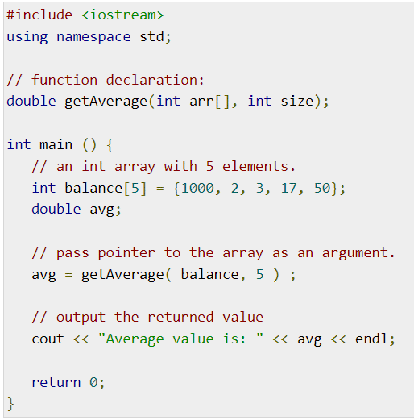

Slide 20
